Slide 1
…to give women an opportunity to explore the effects of menopause through telling their stories, with the intention of creating a support network for other menopausal women and raising awareness of the effect of menopause to all women."
Reclaim the Menopause

Slide 2
Our aim is to break down the stigma attached to the menopause, using storytelling through ceramics.
Conceptual Ceramic Artwork
Community Engagement Activity

Slide 3
Conceptual Ceramic Artwork
1. Support
2. Nest
3. Badge
4. Page
Clare Thorp
i4c Publicity Team

Slide 4
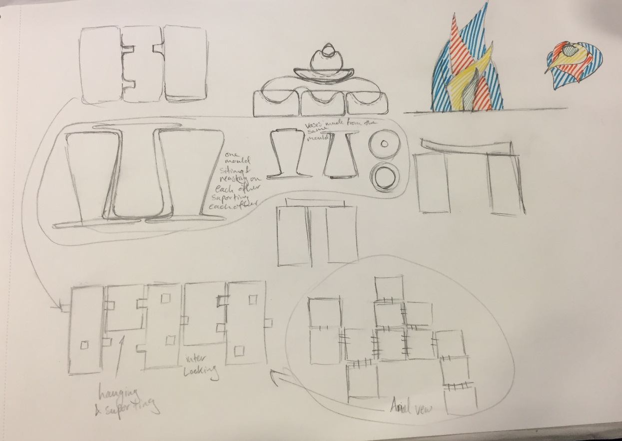
Support
Seeking support during menopause from family and friends is just as important as considering the many options for symptom relief.

Slide 5
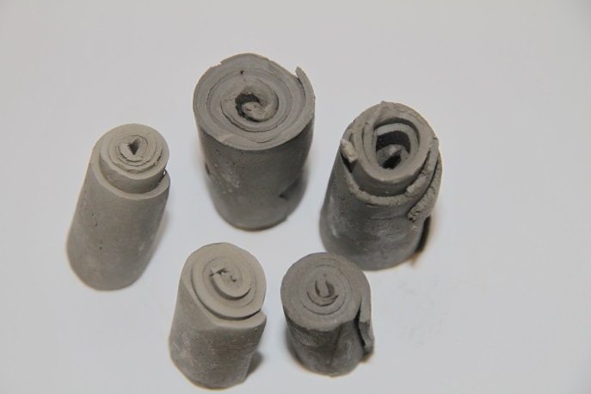
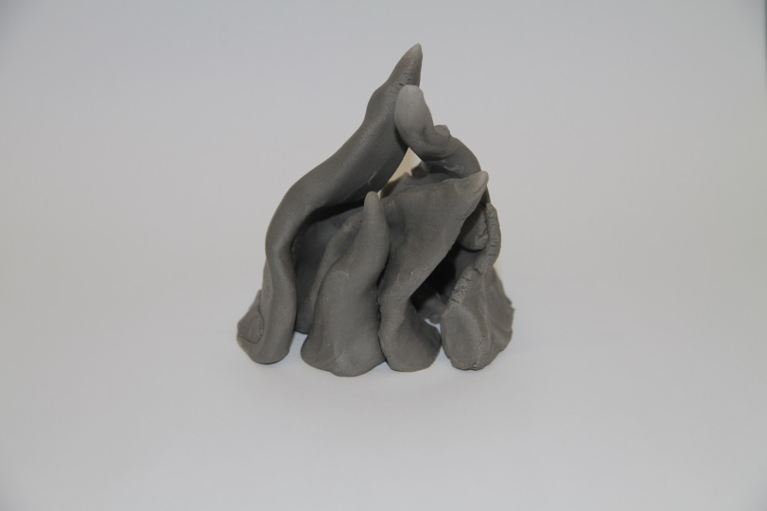
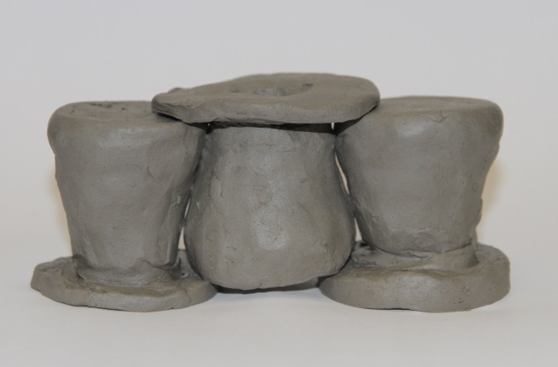
Support

Slide 6
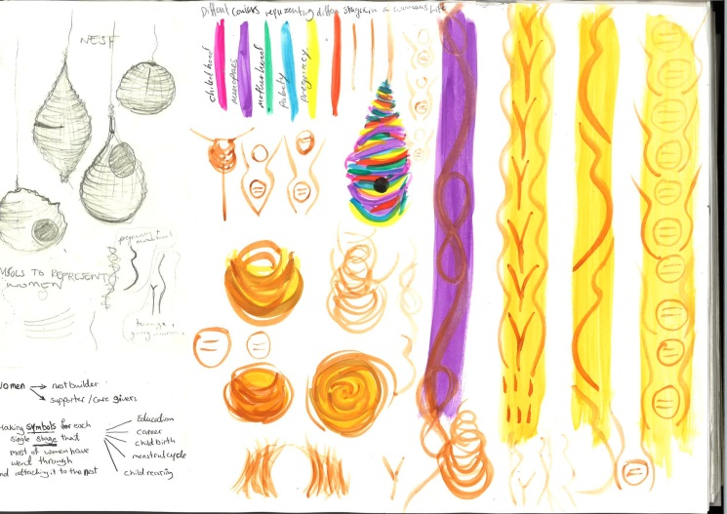
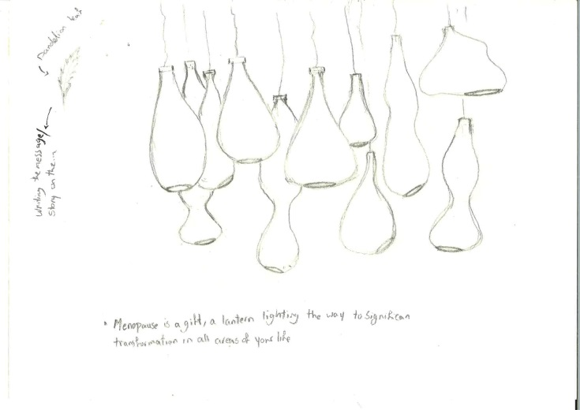
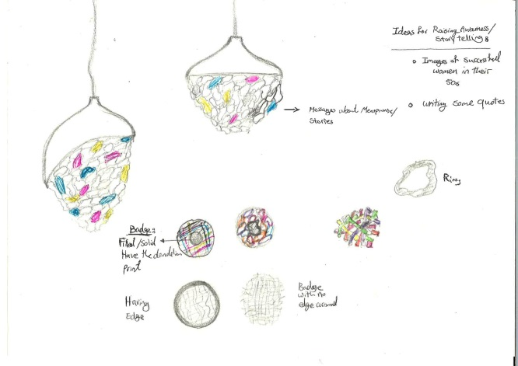
Nest
Women see the world as a family, a nest, a place of beauty. Like the female nest builder, women see themselves as settlers, peacemakers and designers.

Slide 7
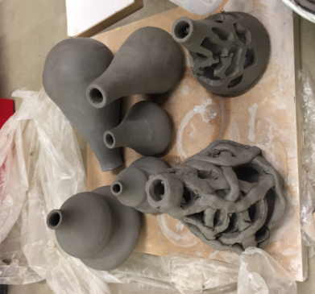
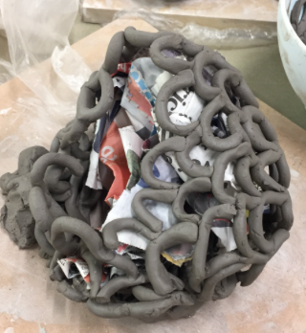
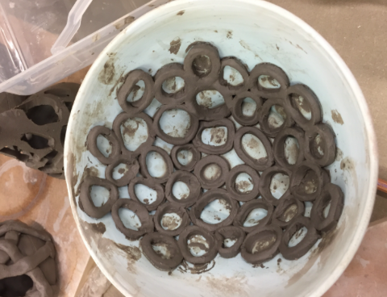
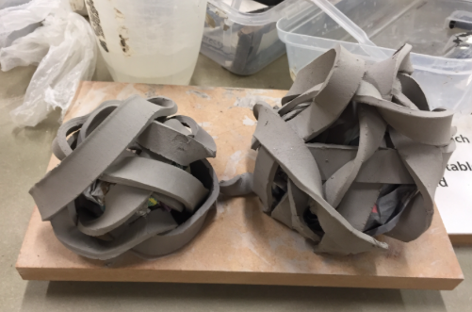
Nest

Slide 8
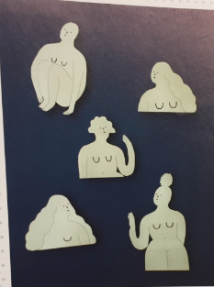
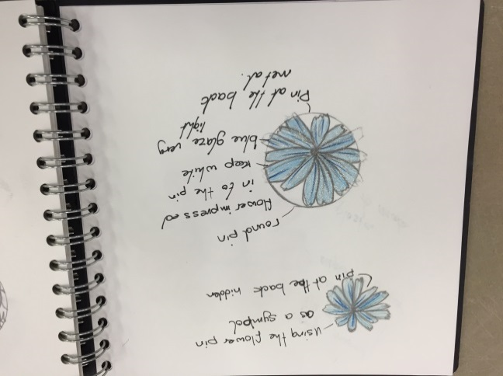
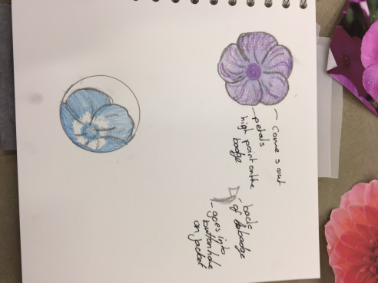
Badge
Badges carry very sentimental value –They can raise awareness and can be passed down between generations.

Slide 9
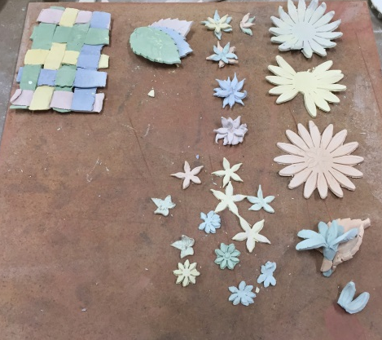
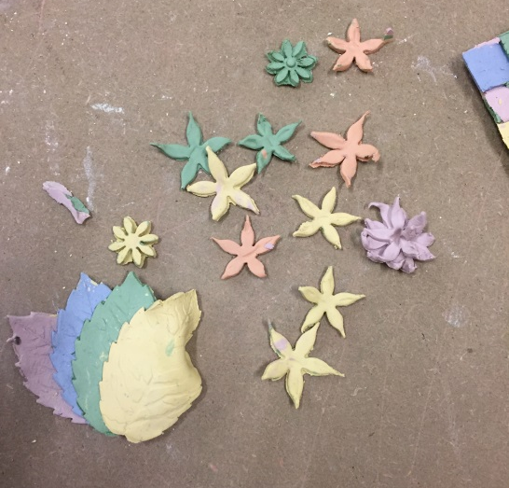
Badge

Slide 10
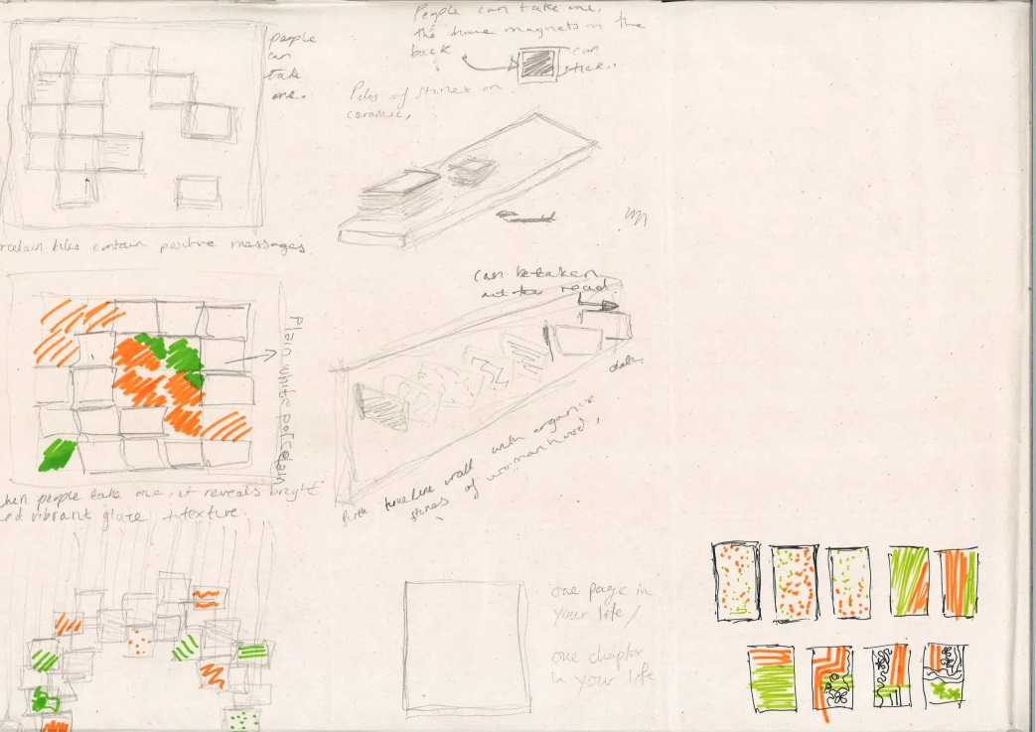
Page
Menopause can be a new chapter in which many women find themselves with a new lease of life.

Slide 11
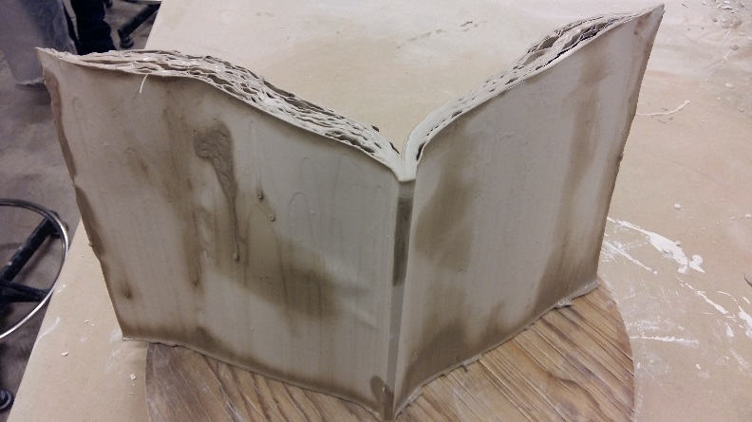
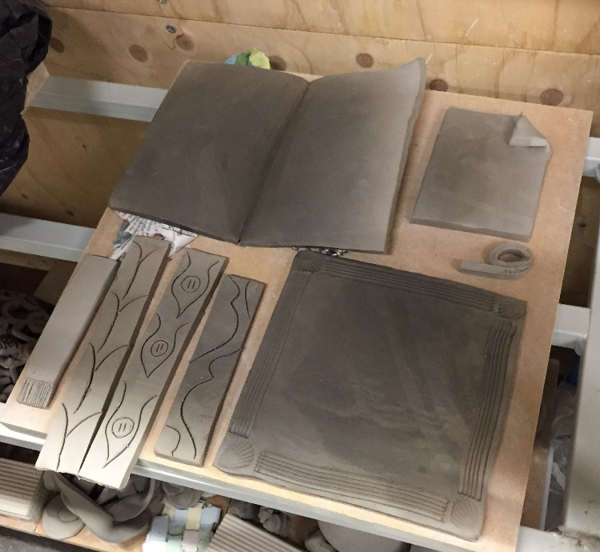
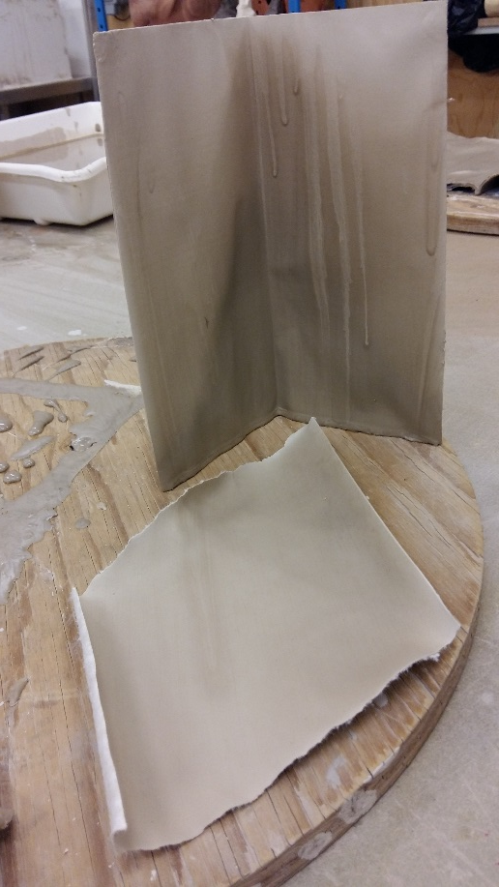
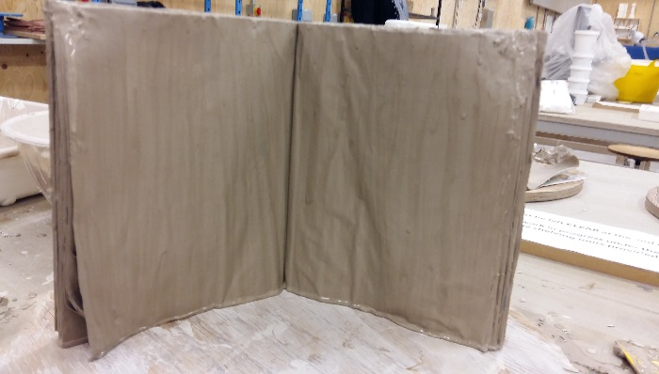
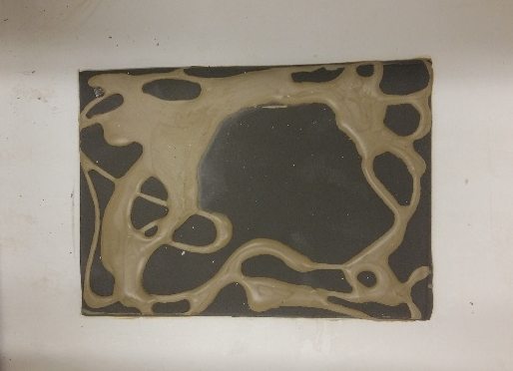
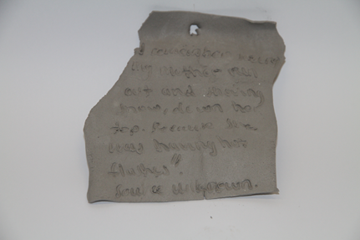
Page

Slide 12
Form
Purpose
Storytelling
Colour

Slide 13
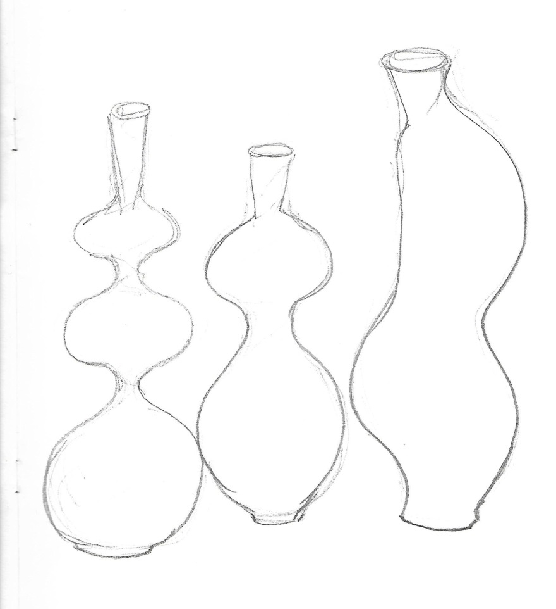
Form

Slide 14
Purpose
To lighten the next generations’ perspective about menopause

Slide 15
Storytelling
Q: What advice would you give to young ladies (next generation) about Menopause?
Anne advices women to accept the menopause as a part of life
Rhonda advises women to talk to their partners as well as their peers and supervisors at work
Anne, 58
Rhonda, 46
Rose suggests that women start their research before they reach the menopause
Rose, 50

Slide 16
Colour

